Slide 1



PROCEDURE FOR ENTRY TO SECONDARY EDUCATION (PESE) AND
THE KENT TEST (11+)

Slide 2
Key dates for secondary transition
Monday 1st June 2026 | Online Registration for the Kent Test opens
Wednesday 1st July 2026 | Closing date for Kent Test registration
Tuesday 1st September 2026 | School applications open
Thursday 10th September 2026 | Date Kent Test is sat.
Thursday 15th October 2026 | Assessment decisions sent to parents/carers
Monday 2nd November 2026 | Closing date for secondary school applications
Monday 1st March 2027 | National Offer Day (emails sent after 4pm)
Monday 15th March 2027 | Places must be accepted/refused
Tuesday 13th April 2027 | Deadline for appeals to be submitted

Slide 3

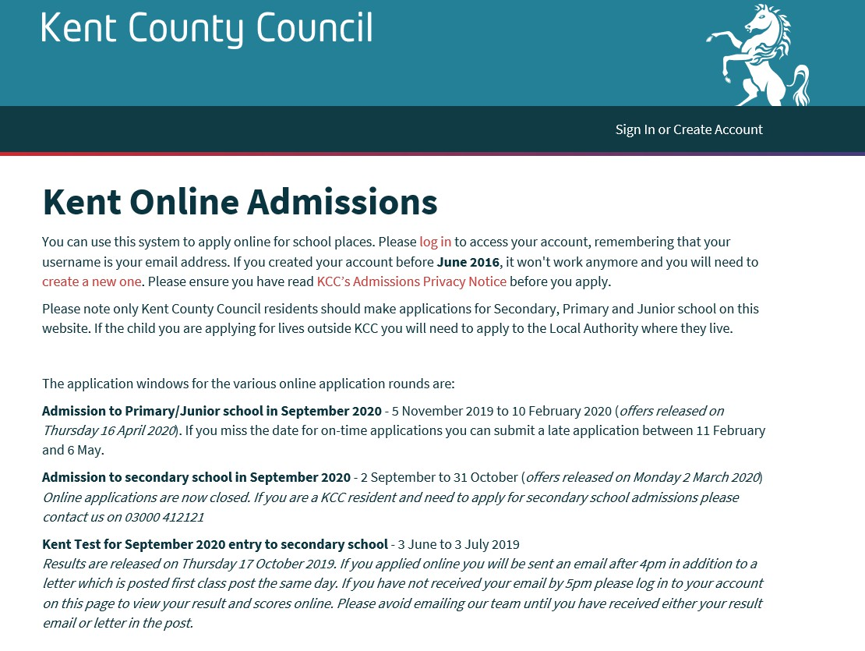
Applying for a secondary school place
The link is www.kent.gov.uk/ola
You can name up to four schools in order of preference.
PLEASE NOTE…
Naming one school does not give you a greater chance
of acceptance.
If you are naming a grammar school, these should be
number 1 (and 2) on your list.
If needed, you can only appeal for schools you have
named.

Slide 4
Local secondary schools
Grammar
Comprehensive
The Folkestone School for Girls
Turner Free School
The Harvey Grammar School
Brockhill Park
Dover Grammar School for Girls
The Folkestone Academy
Dover Grammar School for Boys
Astor Secondary School

Slide 5
Other Local secondary schools
Grammar
Comprehensive
Simon Langton Girls' Grammar School
Canterbury Academy
Simon Langton Grammar School for Boys
St Anselm's Catholic School
St Edmund’s Catholic school

Slide 6
Local secondary schools
The following grammar schools also offer places through their own tests:
Dover Grammar School for Boys & Dover Grammar School for Girls (the Dover Test)
Folkestone Grammar School for Girls & Harvey Grammar School, Folkestone (the Shepway Test)

Slide 7
Children with an EHCP
If your child has an Education, Health Care Plan (EHCP) then the process for applying for a secondary school is different and this should be discussed with Mrs Wilson.

Slide 8
THE KENT TEST (11+)

Slide 9
What is the Kent Test?
The Kent Test is used to assess whether a child is suitable for a grammar school education in Kent. It is commonly referred to as the “11+”.
The questions in the test have been designed and written by experts in order to see how your child performs using different types of reasoning skills and to test their ability in English and maths.

Slide 10
Should my child sit the Kent Test?
We would strongly recommend you discuss with the school, in the first instance, whether a grammar school may be the right place for your child.
We can discuss, with you, the factors to consider when choosing a school for your child – where will they be happier/more confident and more likely to succeed?
We will be here if you have any questions throughout the whole process.

Slide 11
Children with SEND
When you register your child for the Kent Test online, you will need to confirm if you have discussed a request for access arrangements with your child’s school.
The school has to submit requests for access arrangements by the end of June.
Examples of access arrangements provided:
Large print (question and/or answer sheets)
Coloured paper
Laptop for the writing task
Use of equipment, ear defenders, wobble cushions, etc.
Support of a reader
Support of a scribe
Support of a ‘prompter’
Supervision in smaller room
Stop the Clock rest breaks
Additional time (one or more tasks)

Slide 12
The Kent Test (11+)
Your child does not need to take the Kent Test unless you (and your child) are interested in naming a grammar school in your application.
There are three tests:
Maths (30 minutes)
English (30 minutes)
Reasoning (approx. 1 hour)
There is also a Writing Task.
The school will support children through the test but cannot coach children for the test.
Register online at www.kent.gov.uk/ola

Slide 13
When to apply to the Kent Test?
Wednesday 1st July is the closing date for Kent Test registration.
It is not possible to sign up past this date.

Slide 14
On the Day
Children not sitting the test will do a project-based task for the day in a Year 6 classroom.
We will be administering the Kent Test in the school hall and a few smaller rooms for those children with access arrangements. Year 6 staff will administer and a member of staff from another school will invigilate.
Structure of the day:
9.15am: Maths & English
10.45am: Reasoning
1.15pm: Writing Task

Slide 15
Maths & English
The tests are multiple-choice with a separate answer sheet; they are marked by an automated marking machine.
The first test will be an English and Maths paper and will take approximately 1 hour. Each section will involve a 5-minute practice exercise followed by a 25-minute test.
The English section will involve a comprehension exercise as well as some additional questions designed to test literacy skills.
Each paper is marked based on the number of questions correct and this
provides a ‘raw score’. These raw scores are then standardised. This means that the scores are weighted to reflect the child’s age at the time of taking the test.

Slide 16
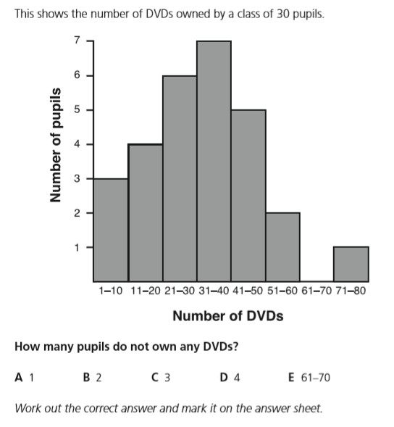
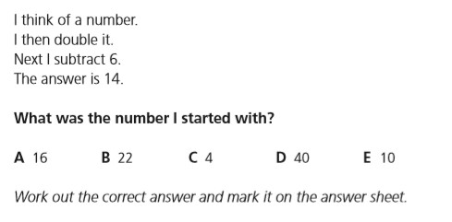
Examples of maths questions

Slide 17
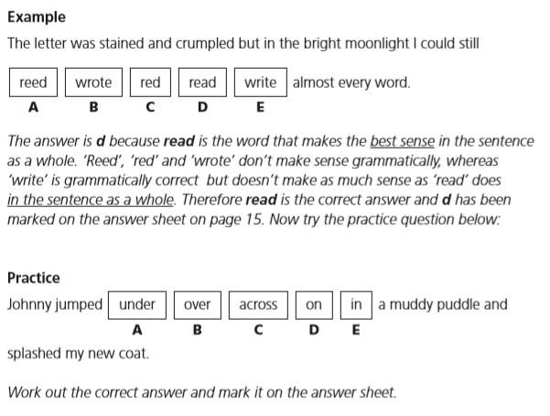
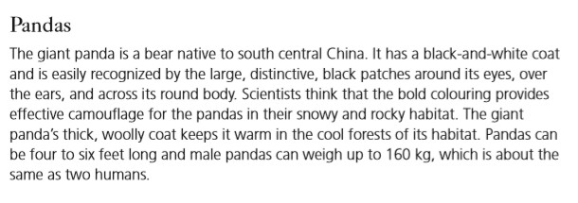
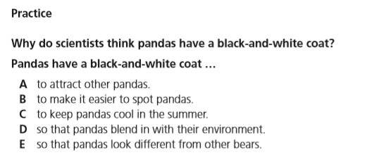
Examples of English questions

Slide 18
Reasoning Tests
The second test will be a reasoning paper.
It will take about 1 hour, including the practice sections and questions.
It will contain a verbal reasoning section and a non-verbal reasoning
section of roughly the same length.
The non-verbal reasoning will be split into short sections, administered and timed individually.
Again, each paper is marked based on the number of questions correct and this
provides a ‘raw score’. The raw scores are then standardised. This means that the scores are weighted to reflect the child’s age at the time of taking the test.

Slide 19
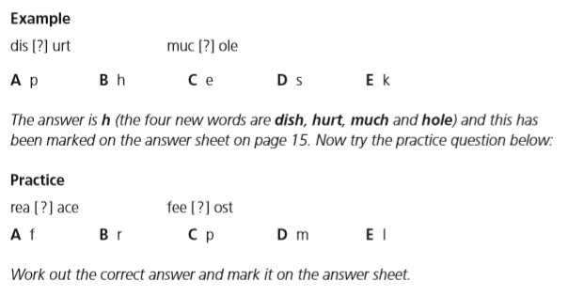
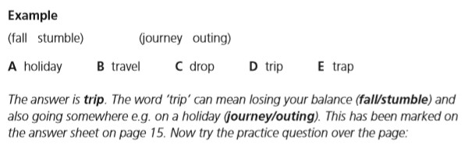
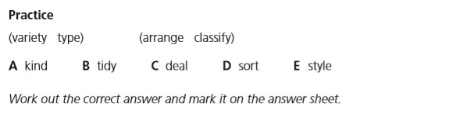
Examples of verbal reasoning questions

Slide 20
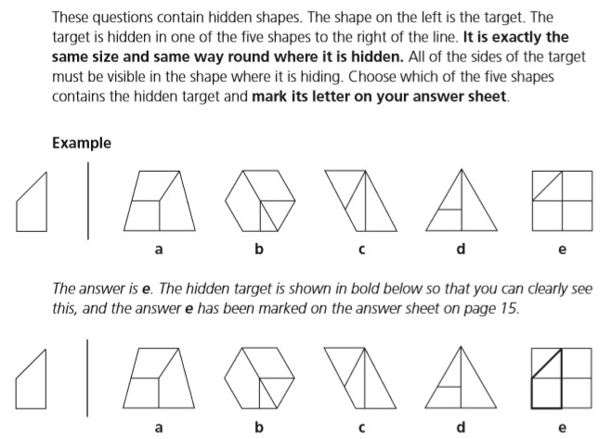
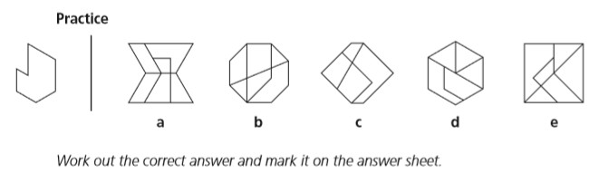
Examples of spatial reasoning questions

Slide 21
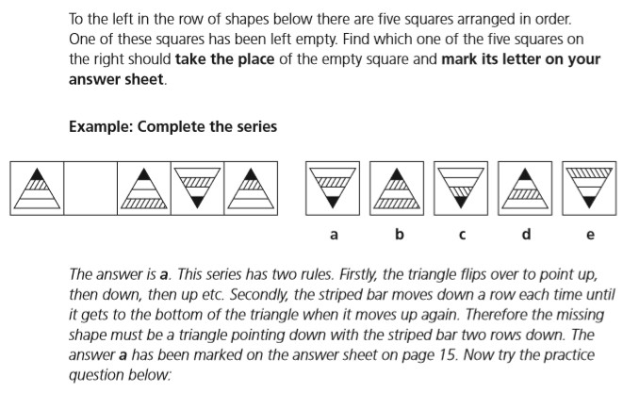
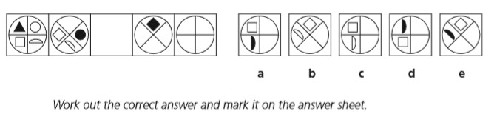
Examples of non-verbal reasoning questions

Slide 22
Writing Task
There will also be a writing exercise which will not be marked but may be used by a local headteacher panel as part of the headteacher assessment stage of the process.
40 minutes will be allowed for the writing task, including 10 minutes planning time.
The quality of a child’s writing is viewed as a key factor when
Headteacher panels assess a child’s suitability for a grammar placement.

Slide 23
Headteacher Appeal Process
If a child does not meet the threshold in the Kent Test, there is still the
‘Headteacher Appeal’ process.
The school will only appeal for a place where we feel that there is
sufficient evidence to support a grammar placement.
The Headteacher Appeal process takes place prior to ‘results day’ and we are not allowed to let you know if we are appealing or not.

Slide 24
Results Day
You will receive an email or a letter saying that your child has:
Been assessed as suitable for a grammar school placement (G)
Been assessed as suitable for a high school placement (H)
Please do not ask us to give you your children’s results on Results Day, we can
only discuss them the following day.
If your child was not tested or was not assessed as suitable for a Kent grammar school, you can still apply for a Kent grammar school but your application will be turned down.
You will then have the right to appeal to explain why you think grammar
school is a suitable option for your child.
This ‘Parental Appeal’ normally takes place in Term 5 (April/May)

Slide 25
What can you do?
Visit the secondary schools with your child. Secondary schools will be
advertising their open days/evenings on their websites.
Involve your child in the decision-making process.
Try to avoid placing pressure on your children – children can feel that they
have ‘failed’ if they do not reach the Kent Test threshold.
Remember that we are here to help.

Slide 26
Key Dates for secondary transition
Monday 1st June | Online Registration for the Kent Test opens
Wednesday 1st July | Closing date for Kent Test registration
Tuesday 1st September | School applications open
 | Kent Test procedure familiarisation in school
Thursday 10th September | Kent Test Date
 | Headteacher Appeals
Thursday 15th October | Assessment decisions sent to parents/carers
Monday 2nd November | Closing date for secondary school applications
Monday 1st March | National Offer Day (emails sent after 4pm)
 | Meeting with Headteacher to discuss parental appeals
Monday 15th March | Places must be accepted/refused
Tuesday 13th April | Deadline for appeals to be submitted

Slide 27
Resources
Kent Test Familiarisation Booklet
https://www.kent.gov.uk/data/assets/pdf_file/0014/14513/Kent-Test-familiarisation-booklet.pdf
GL Assessment Familiarisation Materials
https://www.gl-assessment.co.uk/products/11plus-series-11-plus-practice-papers/11plus-familiarisation-materials/
CGP Materials
https://www.cgpbooks.co.uk/info/preparing-for-the-11-plus-with-cgp/free-11-plus-practice-tests
ElevenPlusExams
https://www.elevenplusexams.co.uk/
None of these links constitute an endorsement by the school or by any individual.

Slide 28
THANK
YOU

